Slide 1




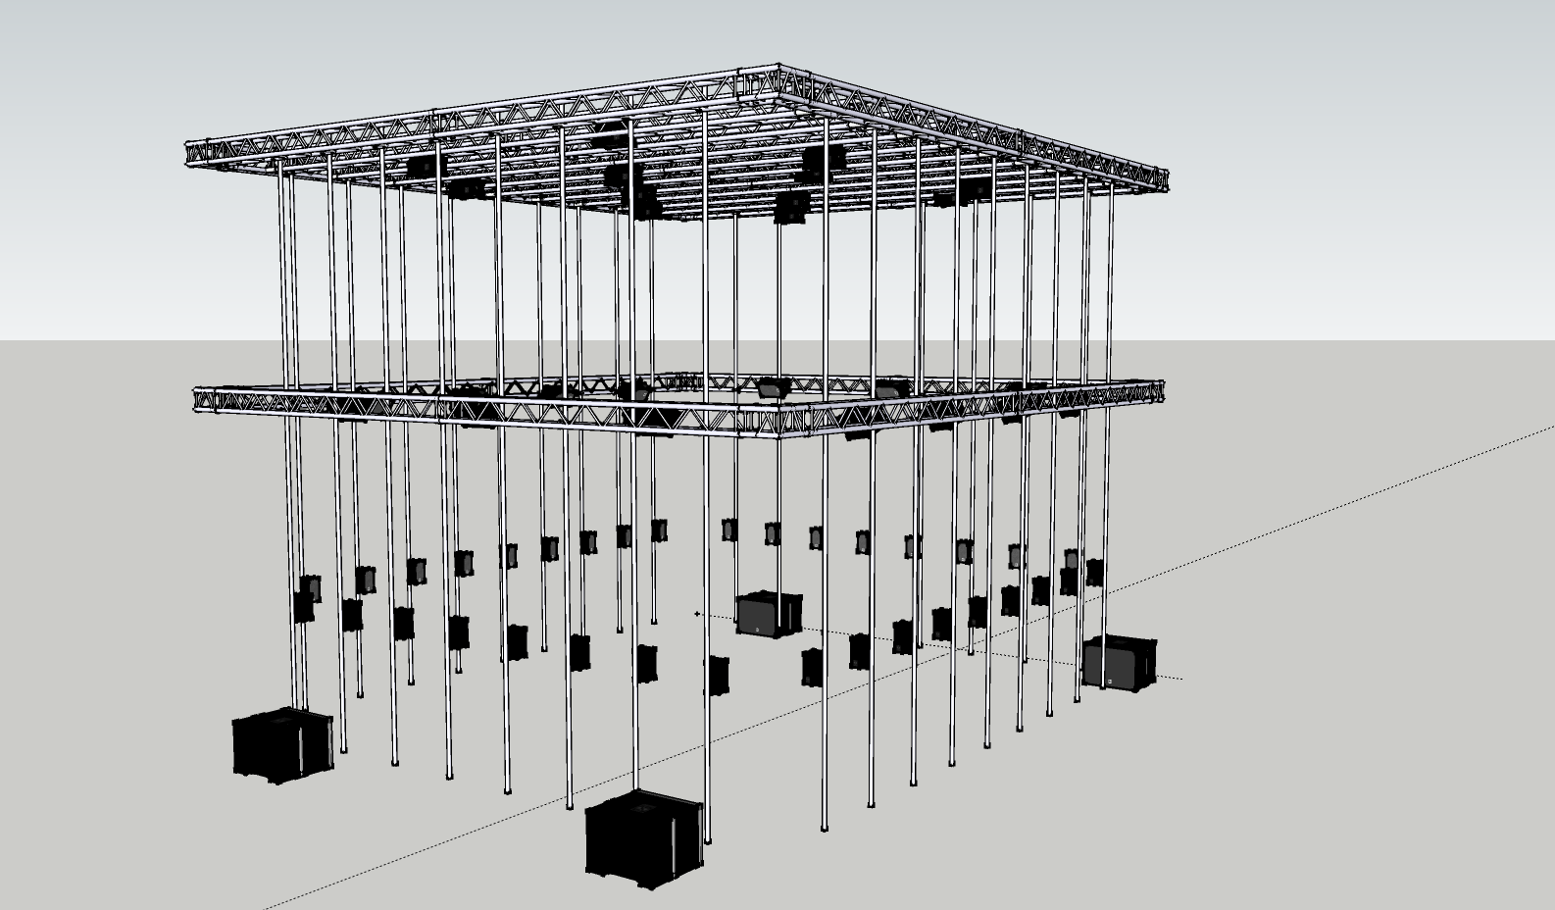


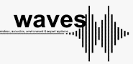








ASIL Infrastructure – February ‘19 Bart Moens – Bart.moens@ugent.be – 07/02/2018

Slide 2
Do Tank Series
Lots of technology => steep learning curve. Therefore: do tanks!
Get a better understanding of the lab and its infrastructure
Provide knowledge how to conceptualize and conduct our experiments
Learning the skills to experiment in the lab
4 different sessions:
Friday 15/2 - 1PM @ ASIL Labs:
main concepts and ideas behind the lab
technological overview of the installed systems
hands-on session to get you started with the basics
Wednesday 20/2 - 10AM @ ASIL Labs
technical tour
Wednesday 20/2 - 1PM & Thursday 21/2 @ 1PM (instead of 10)
hands on session.
Friday 22/2 - 1 PM @ ASIL Labs
Presentation about the advanced topics
Feedback of the hands-on sessions
Will be planned on regular basis and on-demand to keep you updated

Slide 3
About this presentation...
The lab is a work in progress...
So is this presentation & the information
The presentation is a ‘reference’ and documentation for the labs
Some features are still in develment
Marked yellow in this presentation
Presentation and documenation can be downloaded at https://github.com/ArtScienceLab (Lab Documentation)
Also; my spelling check doesn’t work.

Slide 4
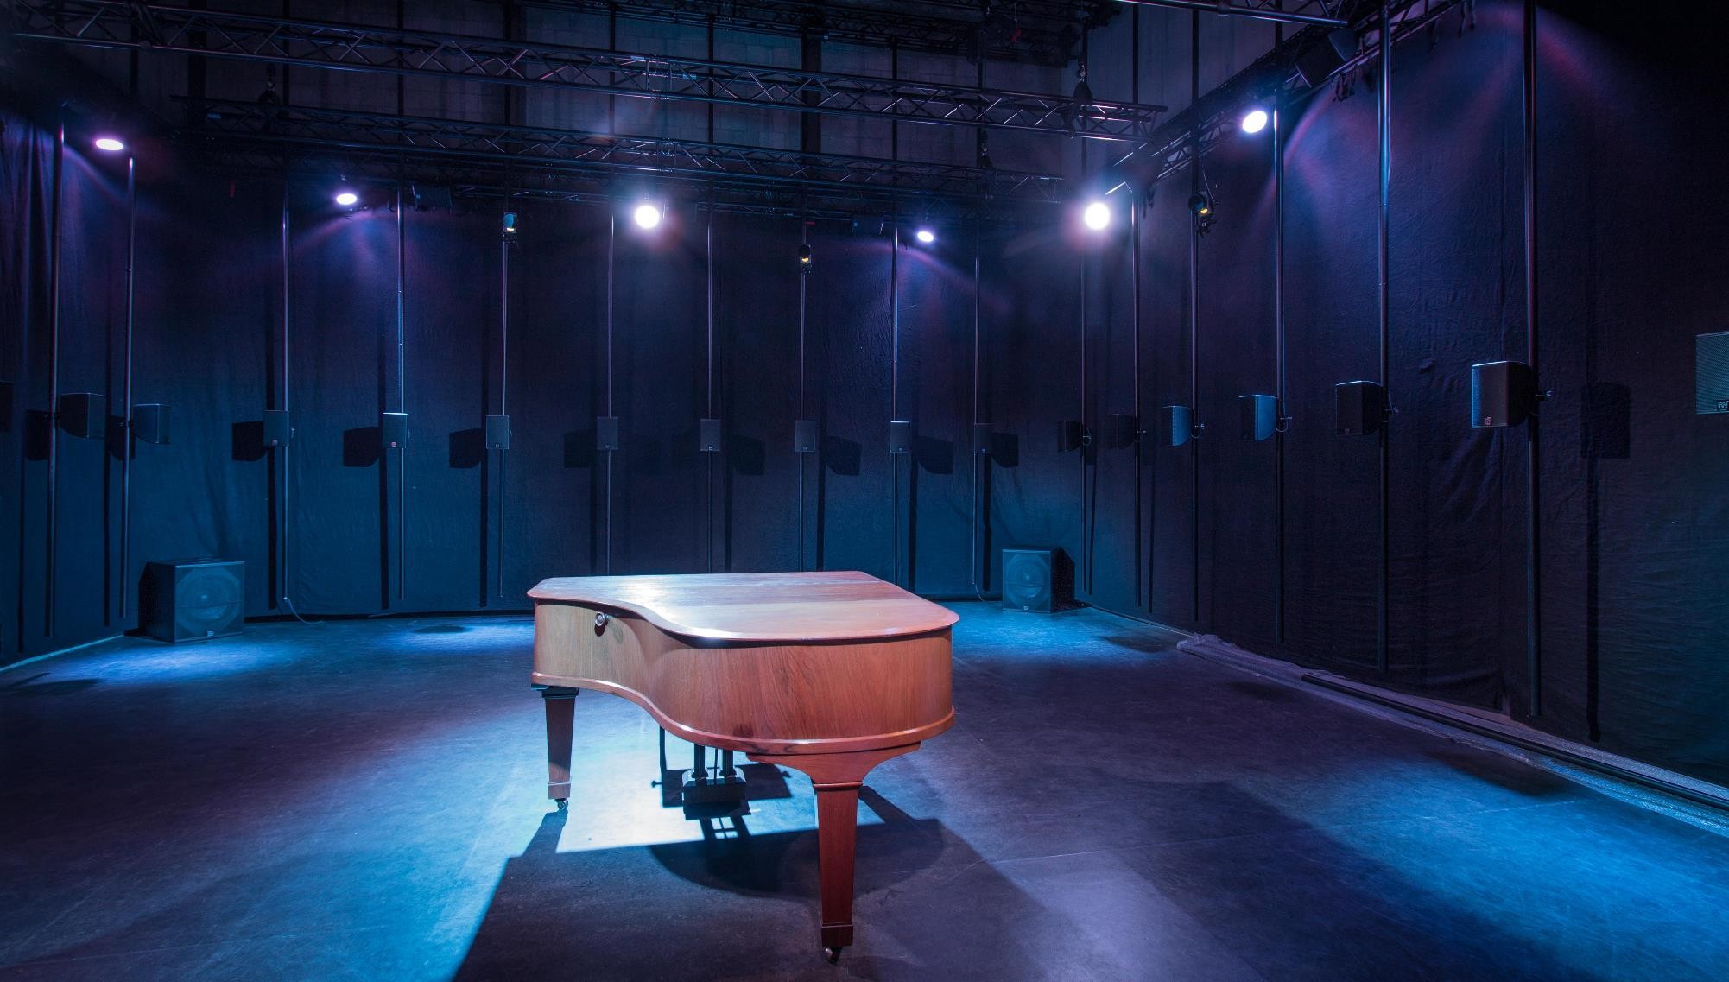
Contents
PART 1: Introduction
PART 2: Practical arrangements
Layout of the Krook -2
Bookings & CMS
Partners & arrangements: IDLab, IMEC, MICT
Lab Rules
Practicalities & Documentation
PART 3: Basic topics
Patching panels
KVM network: computers, screens, mobile desk
DANTE audio
The RACK: “sensor & audio connections”
Motion capture system
Synchronisation
Storage & Data Processing
PART 4: Basic usecases & practice
Presenting in the lab
Playing back audio & audio recording
Synchronous mocap & audio recording
Getting data to your own computer
PART 5: Advanced topics
Central data storage
Electricity
Machineroom
IP network
Speaker installation
3D processor IOSONO & Ambisonics
EEG
DMX Lights
Trussing
Secondary Mocap
Projection screen
VR installation
PART 6: Usecases & Examples
Connecting laptop for presentation+audio
Basic audio input / output recording
Connecting mocap to 3D system
APPENDIX: Documentation
Central documentation hub
Schematics
Cable management

Slide 5
Introduction
ASIL = Art Science Interaction Lab
Multi-purpose room to encompass different experiments from all partners
This implies quite a few things:
Easy to setup & breakdown experiments
Fast to switch setups
Minimalistic
High usability
No compromises in features/technologies
Lab design tries to fit all technologies as a puzzle while keeping this in mind
Goal of ASIL: integrate state-of-the-art technologies to bring context to experiments and performances
Notes:
Culture

Slide 6
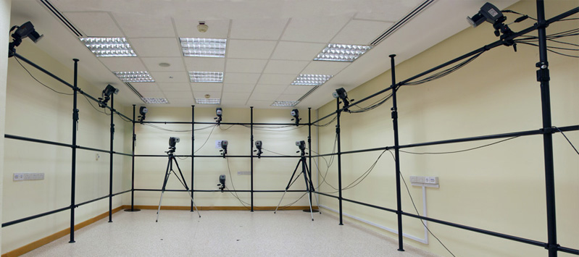
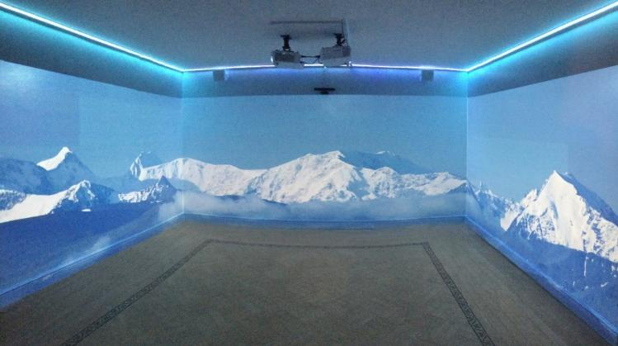
What is context?
Typical motion laboratories are ‘dry’
Results are difficult to apply in real world scenarios
Participants are influenced by this
Immersive lab to emulate scenario’s
Performances
Theatre
Musea
Architecture
New contexts
...

Slide 7
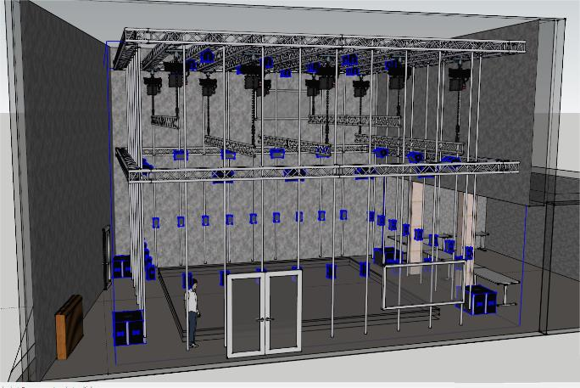
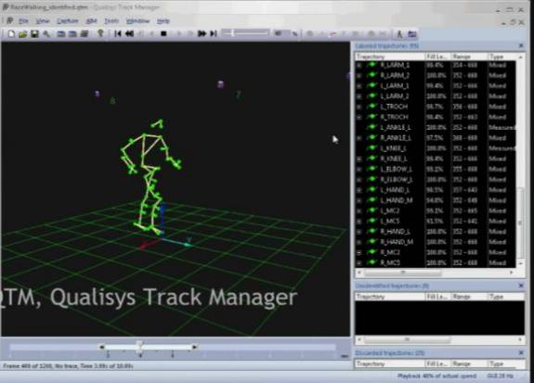
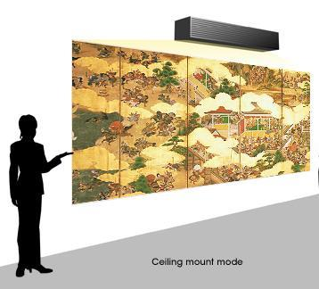
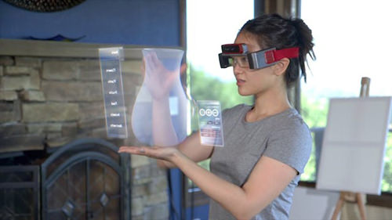
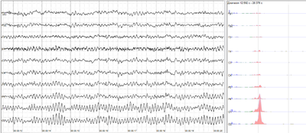
How to deliver context? Technology
62-speaker setup, audio over IP
IPEM
Interactivity / sensors
IPEM
Qualisis mocap system
IDLab
Projection system
IDLab
VR/AR system
IDLab
Eye Tracking, EEG
IPEM, MICT
Central Data Storage
IDLab

Slide 8
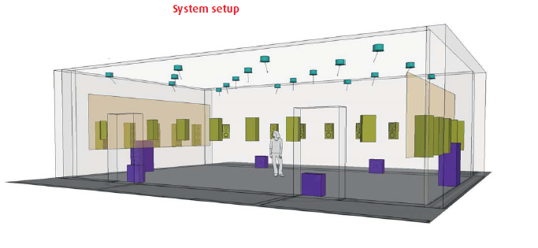
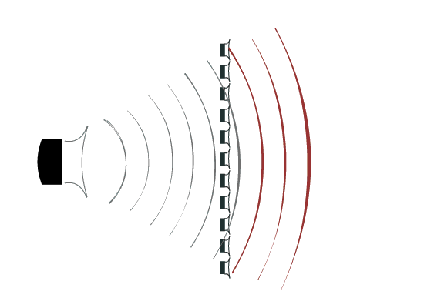
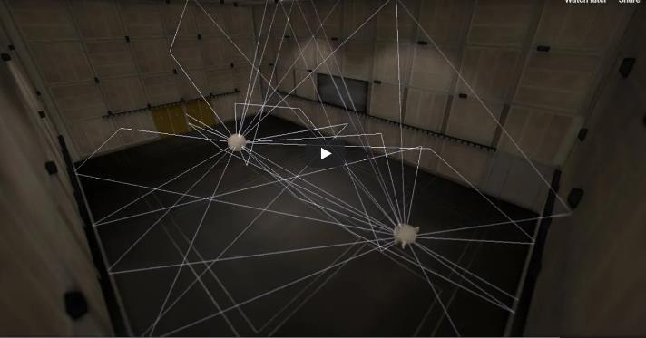
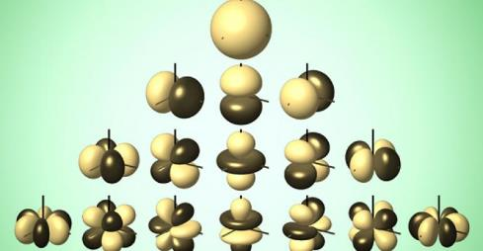
Creating auditory context: Audio rendering technologies
Creating different audio scenarios requires acoustically non-reverberant room.
Wavefield Synthesis Higher order ambisonics Auralisation
Localised 3D audio
Performance oriented 3D audio
Different acoustical settings (church, halls, room, ...)

Slide 9
Creating auditory context: Audio rendering technologies
Auralisation software which will be upscaled to simulate room in room (not only headphones)
Simulate spaces (church, room, temple...)

Slide 10
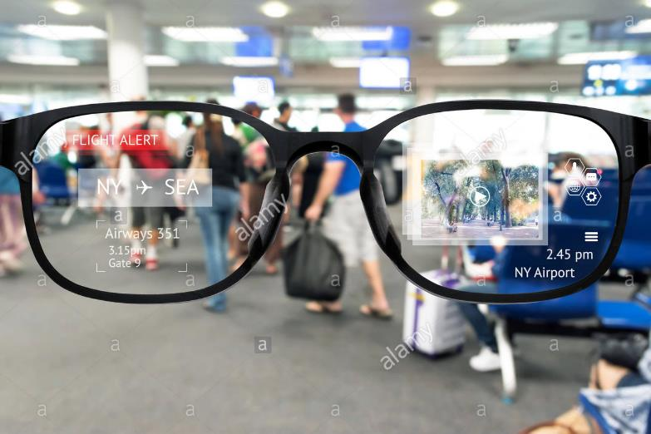
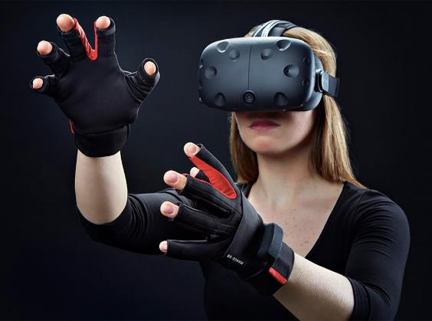
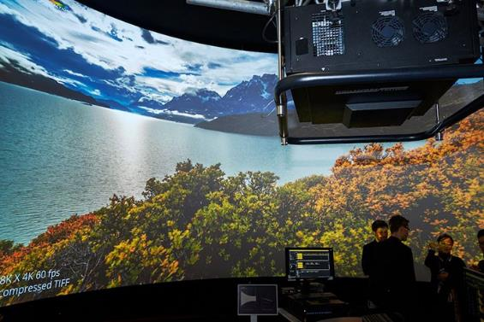
Creating visual context: Video technologies
Projection system Virtual reality Augmented reality
(summer ‘19)
Provide context to groups
Provide individual contexts
Adding information to real-world

Slide 11
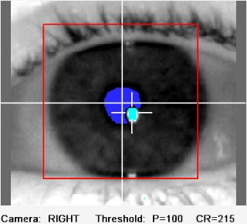
Scientific context: Measuring technologies
Motion capture to track movement
How do people move & interact?
Different & custom sensors (eg on bikes, balance boards, etc)
More detailled body movement
Eye tracking
Getting to know the center of their focus
EEG
Whats going on in the brain?

Slide 12
Social context: Upscaling from individual experiments
Study group interaction with and within context
Large area in lab accommodates groups
Audio system provides stimuli for entire group
Motion capture allows to track 8+ participants
Combining technologies generates group VR/AR experiences
Groups can be a bunch of random people, a band, a tour group for a museum, ....
Location in the Krook adequate for finding participants

Slide 13
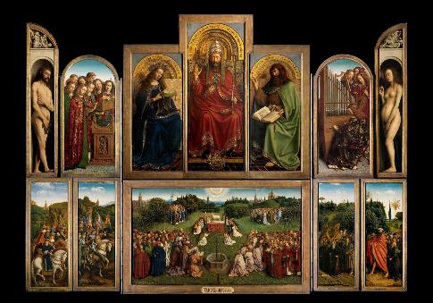
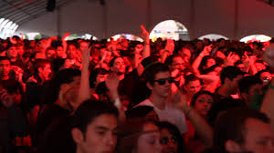
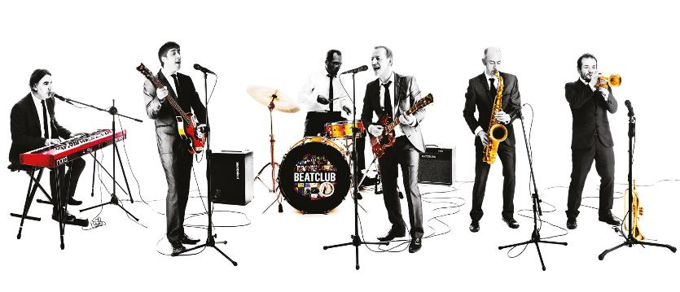
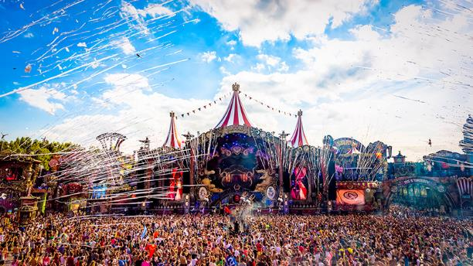
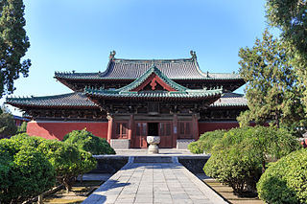
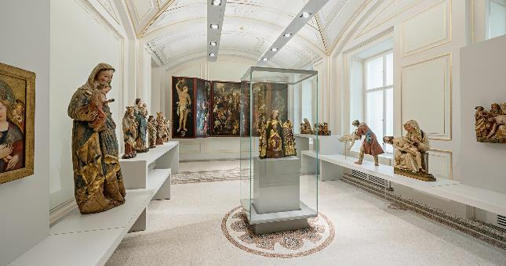
The power of the lab Combining all technologies allows us to create diverse immersive scenarios
Group interaction
Interactive paintings or
behaviour study
Having a band play in different locations
Study group interaction, eg on festivals
Emulating acoustics of a temple
Testing gallery ideas or audience study

Slide 14
Usability of the lab
Designed to quickly change setups
Flexible: trussing system, everything on wheels, inter-lab compatibility
Open-source ideology: download specs of the lab online
Following the new GDPR EU rules for data management
Separate room for sensitive or loud equipment/pc’s
Frequent workshops & training sessions
Technical supervision & maintenance

Slide 15
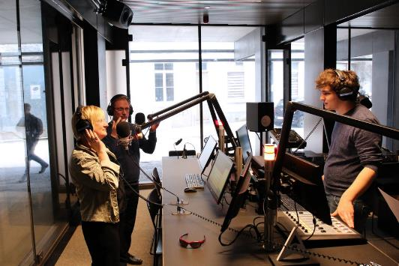
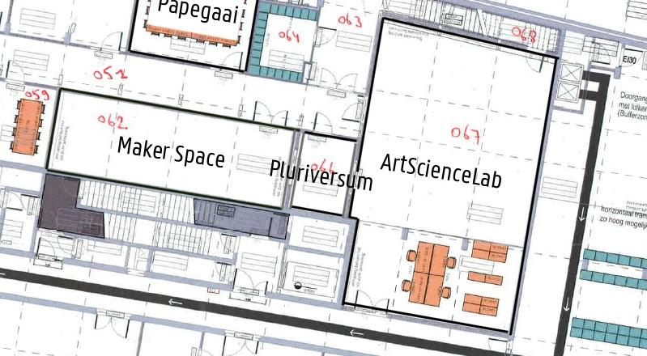
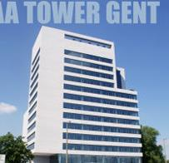
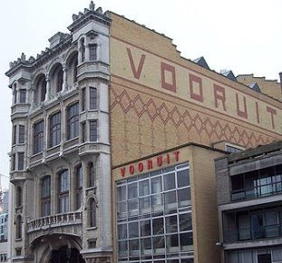
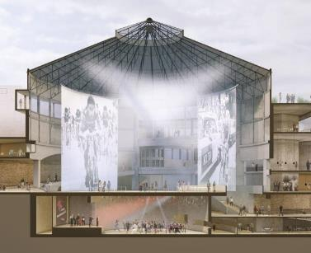
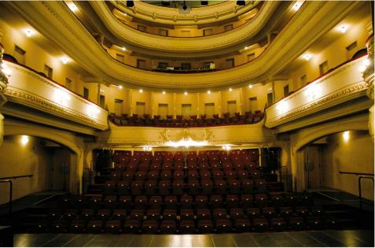

Extending beyond the lab
URGent Radio studio
UGhent Fiber ring
IMEC audio labs
Technologiepark
De Vooruit
Wintercircus
Minard
iTower Zwijnaarde

Slide 16
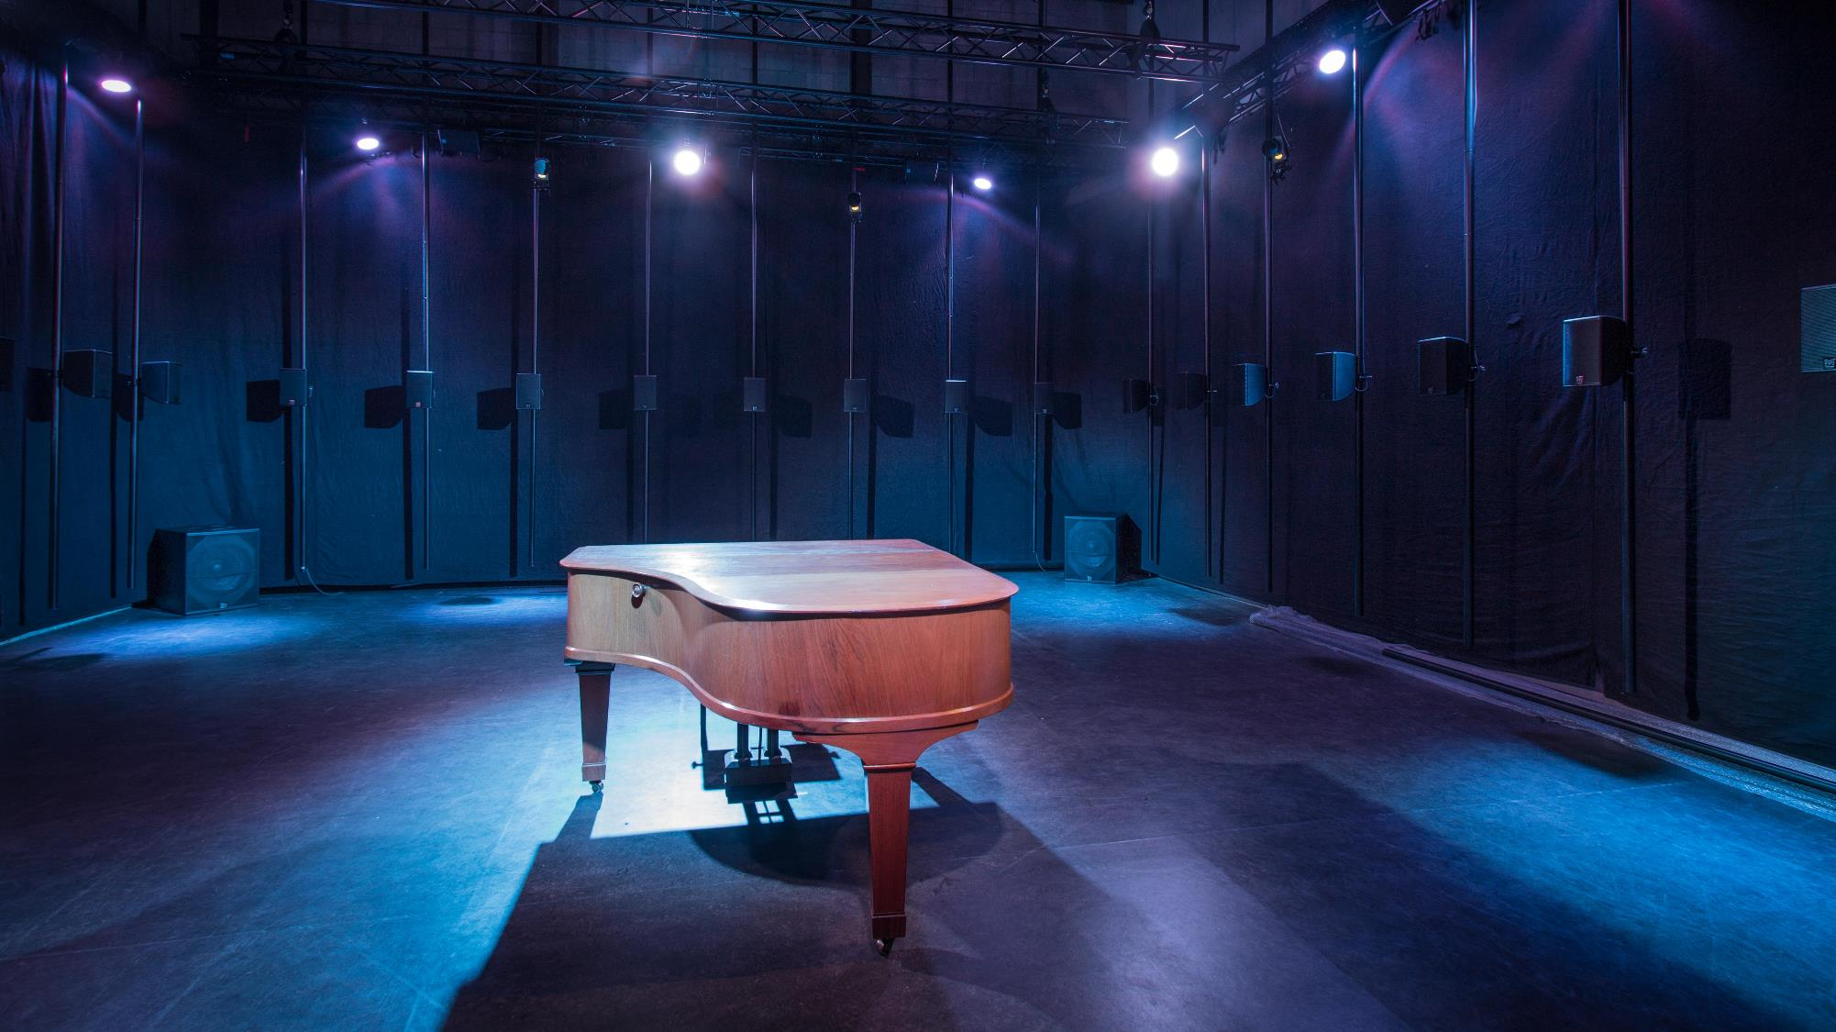
PART 2 Practical stuff
Krook Labs
Bookings & CMS
Partners & arrangements: IDLab, IMEC, MICT
Lab Rules
Practicalities & Documentation

Slide 17
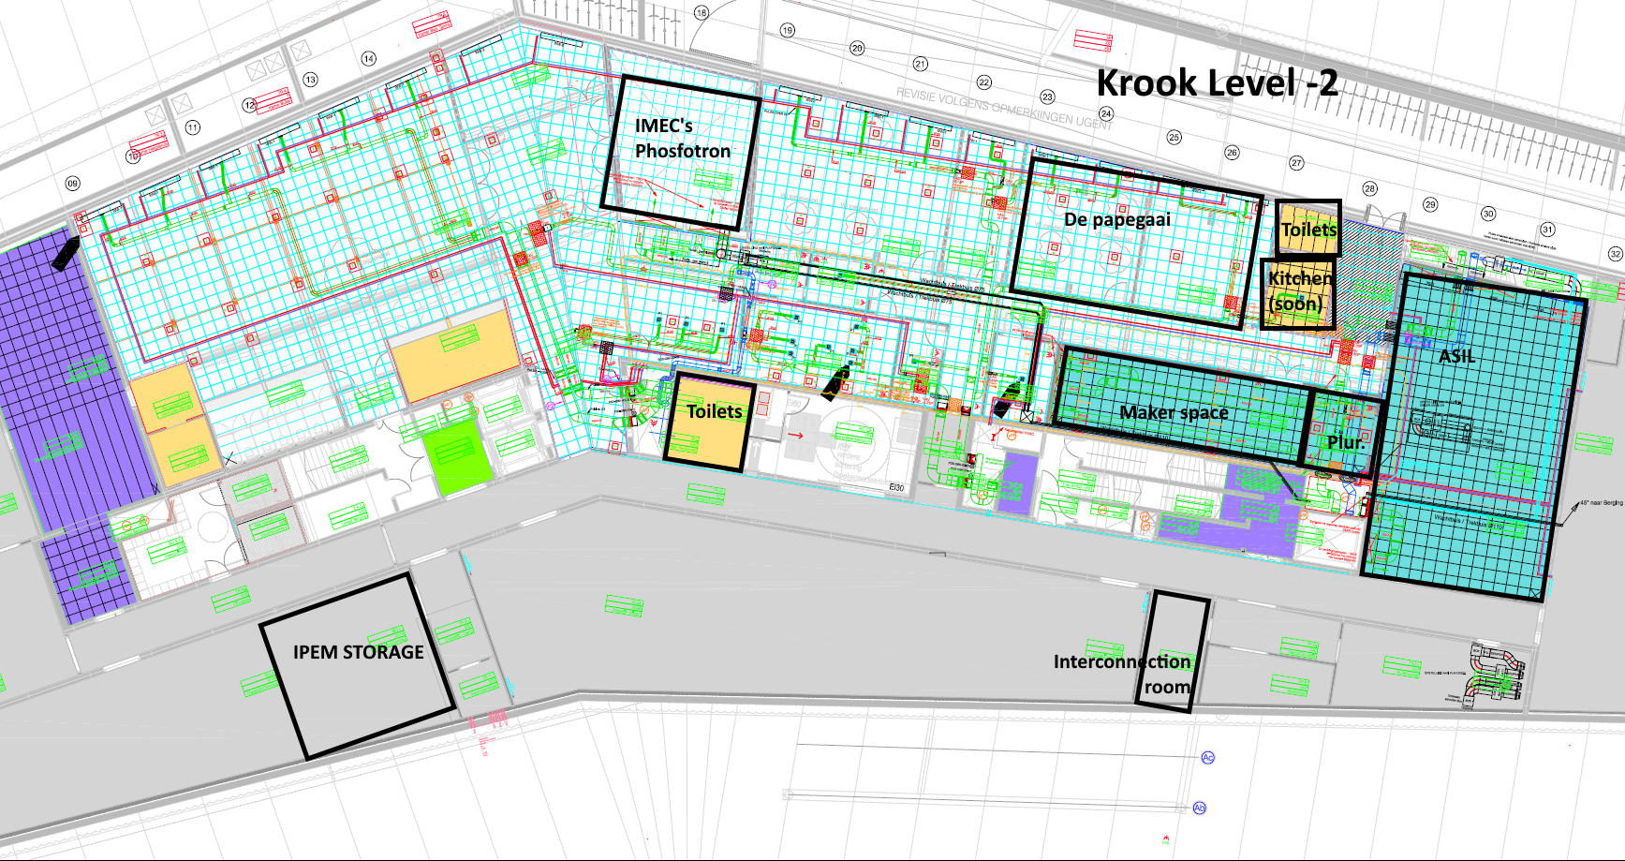
Krook LABS & POI

Slide 18
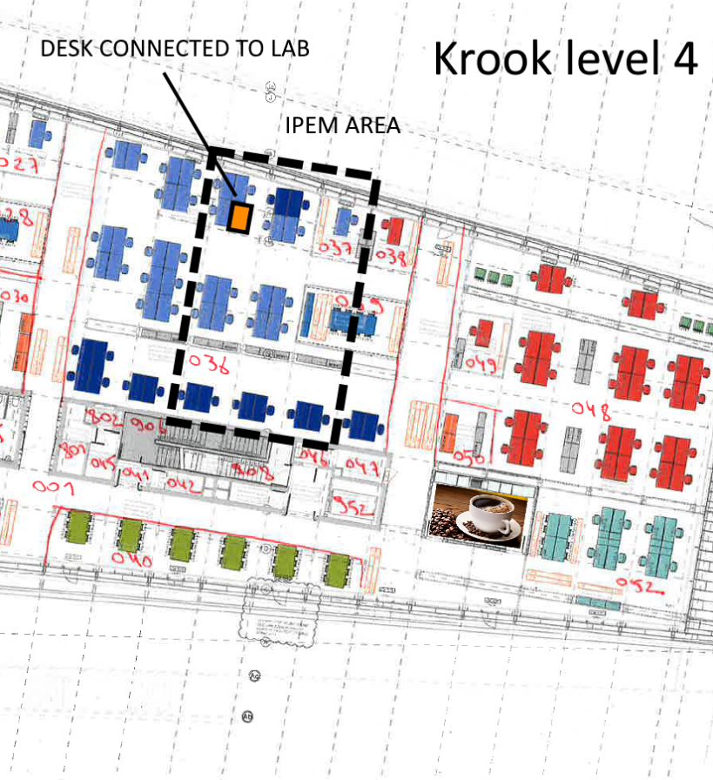
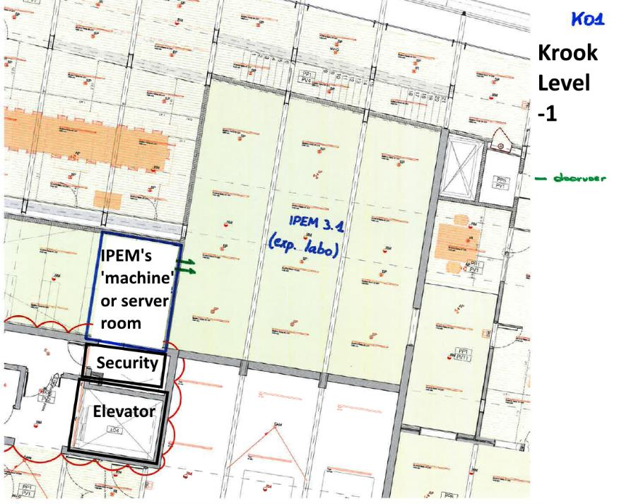
Locations: other levels
SHARED FABLAB

Slide 19
Bookings & CMS
To reserve one of the labs, use IPEM CMS bookings
https://intranet.flw.ugent.be/ipem/Lists/Bookings/calendar.aspx
Use Ugent Login
In case of no acces: mail Aagje Lachaert <Aagje.Lachaert@UGent.be>
Plan your experiment in “blocks
Important to do this well in advance!
For special requests (or IPEM Partners), mail (bart.moens@ugent.be).
(2019) Shared CMS with IMEC, IDLab & IPEM
To reserve the meeting room of the Papegaai (-2): mail to Ann Wouters (Ann.Wouters@imec.be)

Slide 20
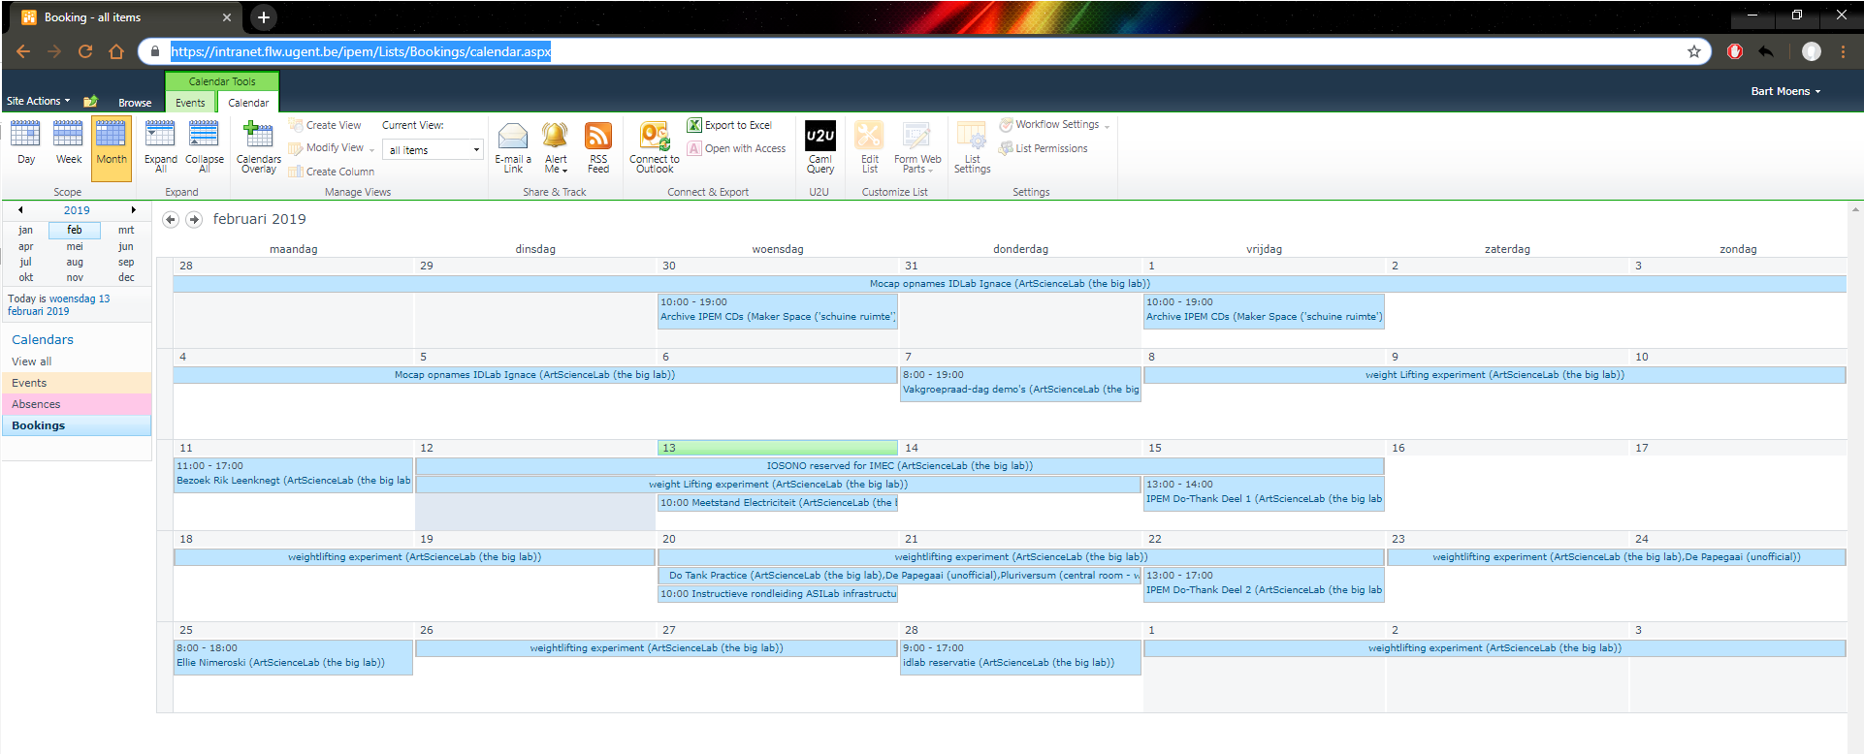
Bookings & CMS
https://intranet.flw.ugent.be/ipem/Lists/Bookings/calendar.aspx

Slide 21
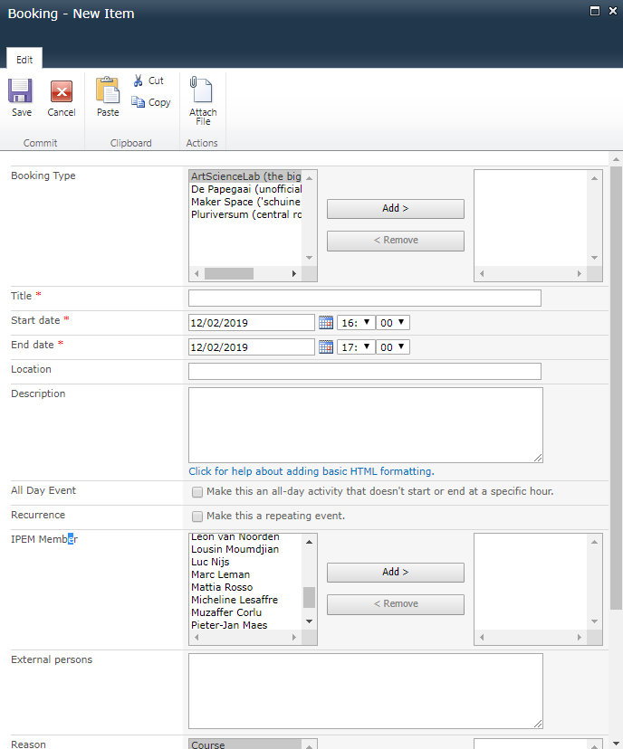
Bookings & CMS
Best practice: be as complete as possible!
Booking type = the lab(s)
IPEM member = who to contact in case of trouble
Reason = course, experiment, maintenance, etc
Also reserve for courses, demo’s, etc
Also reserve equipment (eg for remote setup) o

Slide 22
Partnerships
Lab is shared among IPEM, IDLab & IMEC.
IPEM focusses on audio, IDLab on mocap/video/VR.
We share some infrastructure with IMEC
Current “agreements”:
We can use the 3D IOSONO at any time. IMEC needs to reserve (entered in calendar) or call me in advance.
IMEC & IPEM share the same network – mistakes can happen - be careful that you don’t change their settings
IDLab doesn’t use the lab often but this will change. For now, when they need it and in case of conflict, they get priority (in reasonable terms).

Slide 23
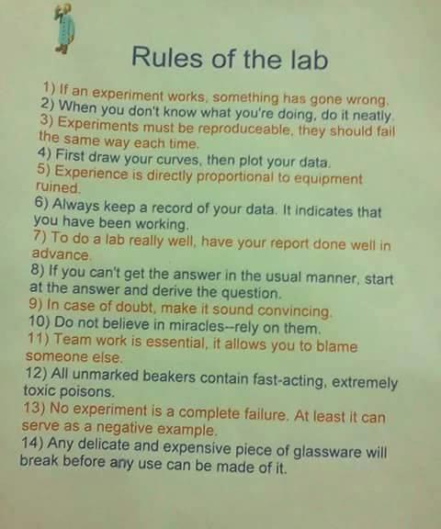
Lab Rules
Leave the lab clean (!)
Sort your garbage (paper, PMD & rest)
No food or drinks at the desks or sensitive equipment
Shut down equipment/power when leaving
Lab coats will become mandatory
More practical guidelines will follow...

Slide 24
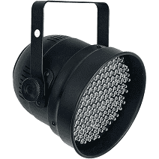
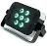
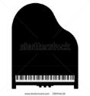
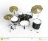
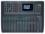
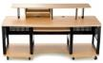
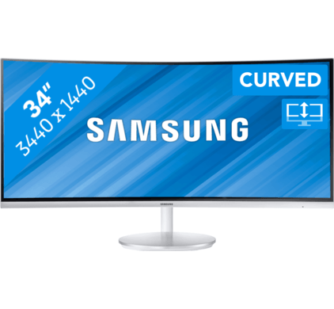
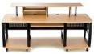
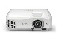
Practicalities & Documentation
Still searching the right layout of the lab for all equipment, feedback welcome!
Machine room
Storage -2
Hoofd Patchpaneel
IN PRK
Praktikabels
Stelling
IN PRK
Truss-sturing
Patchpaneel AMPS
IN PRK
IN PRK
IN PRK
Electriciteits
distributie
IN PRK
IN PRK
Versterkers
Switch
IN PRK
Link naar IMEC

Slide 25
Practicalities & Documentation
Main source: https://github.com/ArtScienceLab (Lab Documentation)
Reservations: https://intranet.flw.ugent.be/ipem/Lists/Bookings/calendar.aspx
Troubles: bart.moens@ugent.be

Slide 26
PART 3 Basic topics
Patching panels
KVM network
DANTE audio over IP
The RACK: “sensor & audio connections”
Motion capture system
Synchronisation
Storage & Data processing

Slide 27
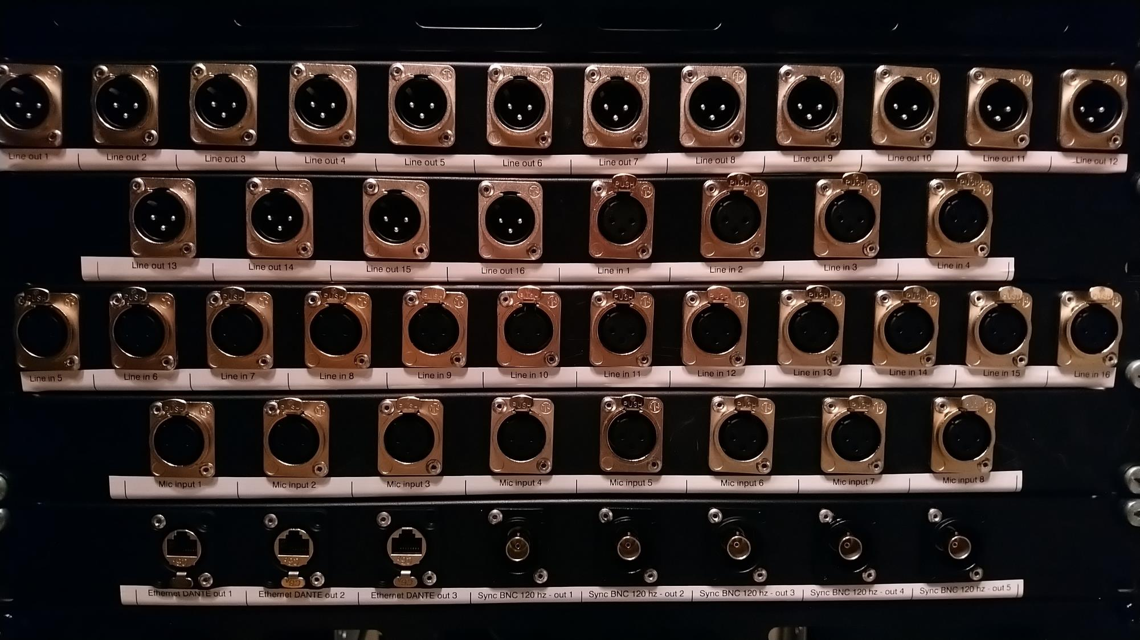
PART 3.1 PATCH PANELS

Slide 28
Patching panels
Main infrastructure is located outside of the lab (in machineroom)
Reduce heat and noise
Better maintainability
Security
Fast reproducability of the experiments
“Minimalism” ideology:
Computers upstairs, screens downstairs
Short cables
How to connect to this equipment?

Slide 29
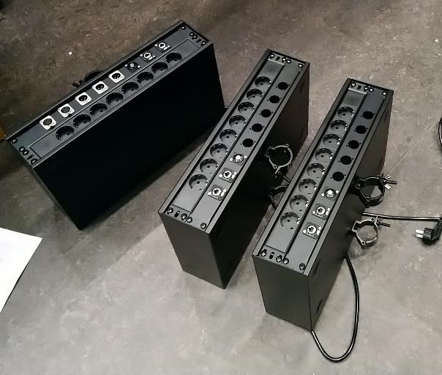
Patching panels
Every setup in the lab starts with the main patching panels
Patching panel is a “block with different connectors”
Power
Network / Dante
Synchronisation
Realtime clocks
Audio connections (for Maker Space & Pluriversum)
All patching panels are directly connected to the central machineroom
Patchers are labelled (patch name, connections...)
note where you connected what for the recreation of a setup!
Currently: 5 patching points, extension to 20 in 2019

Slide 30
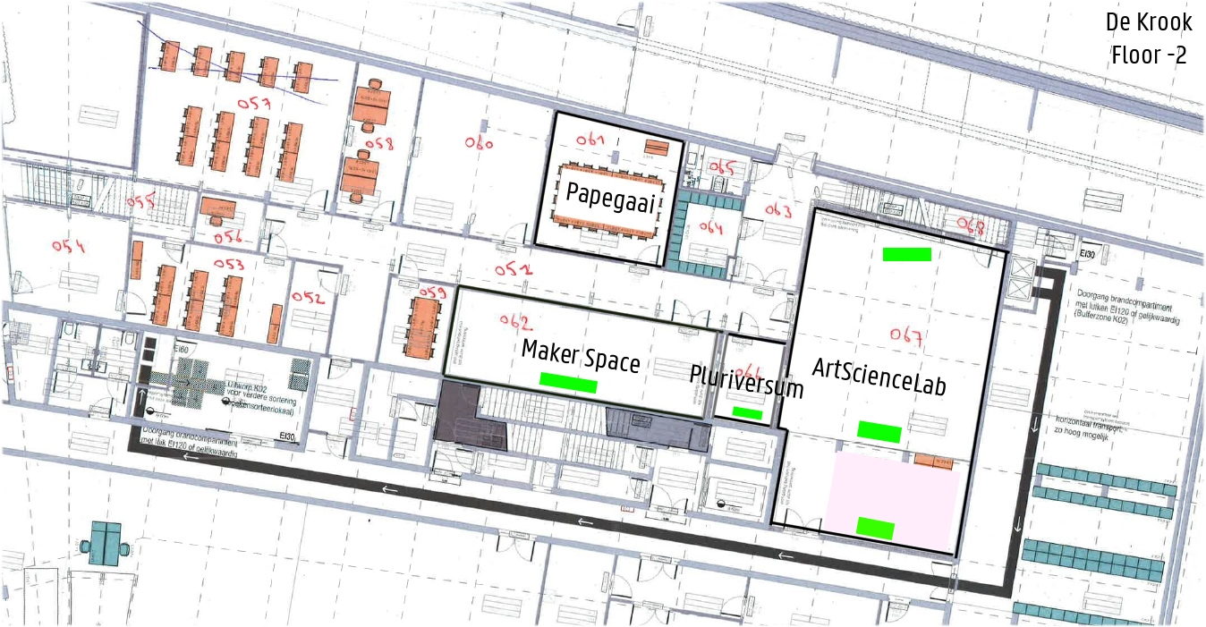
Patching panels
ASIL PATCH 2
PATCH
PATCH
ASIL PATCH 1
PATCH

Slide 31
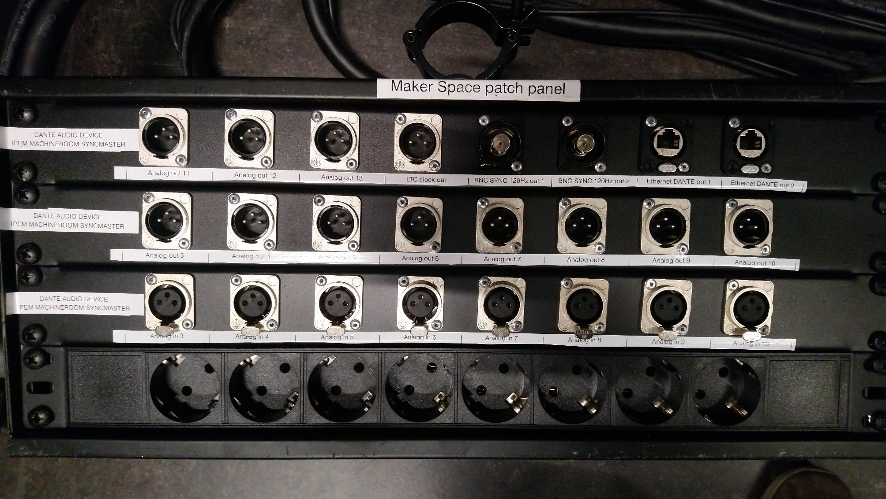
Patch panels

Slide 32

Patch panels

Slide 33

PART 3.2: KVM
Remote connection to computers

Slide 34

KVM infrastructure
KVM = Keyboard, video, mouse
Splitting “computer” and “control interface”
Computers: in machineroom
Screens: in the labs
Connected to each other over standard network

Slide 35
KVM infrastructure
Computers available:
“IDLAB Mocap”
“MACHINEROOM ambisonics”
“RACK PC” Sensor/ableton computer
External laptop input
Storage
VR computers 1 – 3
Screens available:
Big TV screen in the lab
Big desk (2 computers at once)
Small desk
Remote desk at +4
Projectors
Show any computer at any screen
Share screens: show one computer on multiple screens
Do data processing or preparation at the +4 desk
Extends over the 3 labs!
Hotkey: “CTRL – CTRL – O” to switch computers

Slide 36


KVM: the mobile desks
Each desk connectable with only 2 cables to the patch panels
Big desk controls two pcs (two left screens + left kb/m); (single right screen + right kb/m)
Has two audio monitors to preview audio
Big desk has two drawers for notes and stuff

Slide 37

KVM: the upstairs desk
Get your vitamine D4 while working

Slide 38

KVM: the upstairs desk
Get your vitamine D4 while working

Slide 39
Which computers for what?
IDLAB Mocap
“MACHINEROOM ambisonics”
Audio applications (eg ambisonics)
Secondary labs
“RACK PC” Sensor/ableton computer
Main powerhose PC
Recording audio, iosono, etc...
External laptop input
Connecting your laptop to KVM screens
Storage
Storing all data from other computers

Slide 40


KVM infrastructure howto: using computers
TV screen & upstairs: turn on screens, select computer
Mobile desks:
Connect power cable
Connect ethernet cable (from front desk) to any patch panel ethernet
Power on
Select computer
Switch computers: press “CTRL CTRL O”

Slide 41
KVM infrastructure howto: connecting laptop
Find the white small desk
Connect to patch panel (power & UTP)
Connect HDMI cable to laptop
If remote control from other locations is needed, connect USB cable
Connect dante USB for audio to the speakers
Select “external laptop in” on any screen

Slide 42




KVM infrastructure schematic
IPEM lab (-2)
19” mobile rack
IPEM lab (-2)
Audio Ableton Computer (1)
4x USB 3.1 midi/HID
Dual screen - 2x HD video DVI
4 x USB 2.0 (keyb, mouse, storage)
Kinect V2
MOBILE DESK 1
Switch to either of the 6 inputs
Arduino / Teensy
Wall/Floor plug
Soundcards
KVM DS
Webcams
Wall/Floor plug
KVM DS
IPEM server room (-1)
Wall/Floor plug
KVM SS
Audio Ambisonics Computer (2)
Dual screen - 2x HD video DVI
4 x USB 2.0 (keyb, mouse, storage)
KVM DS
Wall/Floor plug
MOBILE DESK 2
Switch to either of the 6 inputs
CAT6 shielded
In zelfde rack
Wall/Floor plug
Mocap Computer (3)
Dual screen - 2x HD video DVI
4 x USB 2.0 (keyb, mouse, storage)
Wall/Floor plug
KVM SS
10 x CAT6 shielded
40m max
KVM DS
Wall/Floor plug
Storage Computer (4)
Single screen - 1x HD video DVI
4 x USB 2.0 (keyb, mouse, storage)
IP switch
Wall/Floor plug
Monitor station
(single screen)
Switch to either screen
KVM SS
Wall/Floor plug
VR Computer (5)
Dual screen - 2x HD video DVI
4 x USB 2.0 (keyb, mouse, storage)
Virtual Reality: 2880x1600, 90hz
Displayport >= 1.2; 1 USB 3.0
(Optional) CAT6 shielded
Wall/Floor plug
KVM SS
KVM DS
Internal IP infrastructure
Via Fiber & bestaande switches
IPEM offices (+4)
Optional FIXED DESK
Switch to either of the 6 inputs
Video Computer (6)
Dual screen - 2x HD video DVI
4 x USB 2.0 (keyb, mouse, storage)
3 X Displayport/HDMI 1.4 out
4K resolution
KVM DS
4K extender
One to One
3x CAT6 shielded
3 x 20m max
4K receiver
(DP/HDMI in) 4K beamer
KVM DS
4K extender
4K receiver
(DP/HDMI in) 4K beamer
4K extender
4K receiver
(DP/HDMI in) 4K beamer

Slide 43

PART 3.3: DANTE Audio over IP
What is DANTE?
Why DANTE?
Using DANTE
Running Dante Controller
Running Dante Virtual Soundcard
Device naming in the lab
The power of DANTE: presets

Slide 44

What is DANTE?
“Dante is a hardware and software solution that transports precisely timed digital audio between devices using standard IP networking”
Dante = multichannel audio protocol over ethernet
Dante is not “a device”! Its a way to bring audio from device A to B as fast & flexible as possible.
Dante replaces classical XLR cabling
Created by Australian company Audinate
Requires mordern network infrastructure (CAT6); wifi is not supported to transfer audio

Slide 45



Why DANTE?
64 speakers is not ‘easy’
Flexible, patchable, extensieve
1-cable installation
Agreed protocol in the Krook
Direct audio connections & shared infrastrcutre
Partners: IMEC – IPEM – URGENT
Future extensions over fiber to Vooruit, Wintercircus, Minard, ..
Krook = multimedia hub for cultural Ghent!

Slide 46

What is DANTE?
What does Dante NOT do?
Sample rate conversion (use 48khz)
Level control (mind the volume)
MIDI
SMPTE time code
Downsides:
Not open source: propriatary licences
We can accidently mess up connected labs
Learning curve!
Do not expect Plug & Play for a 64 speaker system - although I try to make it as easy as possible
Difficulties with linux

Slide 47





DANTE Enabled devices
Devices can implement DANTE
Amplifiers
Speakers
ADC’s
DAC’s
Mixers
Soundcards
PC’s
...
All lab equipment

Slide 48
Using Dante
Dante requires the “routing software”: a piece of software that decide which audio channels go where
“Dante controller” for windows & mac
Freely downloadable at https://www.audinate.com/products/software/dante-controller

Slide 49

The Dante Matrix
Route audio singlas from transmitter to receiver
Transmitter = on top of the screen
Receiver = left on the screen
Click the interconnection to make the audio line (cfr connecting the cable)

Slide 50

Using Dante
How to get sound out of your computer?
Dante hardware ‘soundcard’: High perforamnce: dante-input card
Latencies < 1ms
Studio setup
>1024 channels
Enables connection to and from complete dante network!
Present on both the RACK PC and AMBISONICS PC
Dante virtual ‘soundcard’
Downloadable software
Enable dante on normal PC hardware
Latencies > 4ms, < 10ms
Max 64 channel
Enables connection to and from complete dante network!
Licences: mail me!

Slide 51

Using Dante Virtual Soundcard (own pc)
Connect your computer to the lab network
Check in dante controller if devices appear
Start dante virtual soundcard
On OSX this goes okay by default
On windows you have 2 choices:
WDM = windows sound (eg spotify -> speakers)
ASIO = low latency audio for DAW applications
Make the required routing (eg to speakers)
From any app (eg max, Ableton, ...)
Play!
MIND THE VOLUME! Start low. Thanks.

Slide 52
Dante devices: naming conventions
ORGANISATION – LOCATION & WHAT
IPEM – AMP1 = First IPEM Amp
IPEM-MACHINEROOM-SYNCMASTER = masterclock in machineroom and also audio in out for pluriversum & maker space
IPEM-RACK-PC = pc in the rack (the dante soundcard)
IPEM-RACK-MICINPUTS = Microphone inputs in the rack
IPEM-RACK-ANALOG-IN-OUT = line in/out from the rack

Slide 53

DANTE DEVICES

Slide 54

Speaker numbering & AMPS
IPEM AMP 1
Speakers 1-8
Ceiling
IPEM AMP 2
Speakers 9-16
Entrance side RING
IPEM AMP 3
Speakers 17-24
URGENT side RING
IPEM AMP 6
Speakers 41-48
URGENT side
IPEM AMP 4
Speakers 25-32
Entrance side
IPEM AMP 7
Speakers 49-56
Regie-zijde
IPEM AMP 5
Speakers 33-40
Schermzijde
IPEM AMP 8
Speakers 57-58
TV Speakers
IPEM AMP 9
Speakers 59-62
Woofers

Slide 55
Dante presets
Powerful tool for easy recreation of demo’s or experiments
Saves all audio routing throughout the network in 1 file
Can be recalled at any time to recreate the setup

Slide 56

DANTE best practice : presets & storage!

Slide 57
DANTE exercises
Play sounds to a specific speaker from the operating system
Play sounds to a specific speaker from a professional app (eg Ableton, max msp, etc)
Route a microphone to record on your PC

Slide 58

Part 3.4: The Rack
The main central Audio component to connect audio, sensors & midi to

Slide 59
“The Rack”: Why?
When everything is upstairs in machineroom, why the rack?
Problem: USB connections are not reliable over KVM network
Then, how to connect sensors and midi devices?
One pc (“RACK PC”) remains in the LAB
Basically, we want it to be close to the sensors
Connect to network => becomes available on the KVM & DANTE network

Slide 60
The Rack: Why?
Only requires two cables to be functional:
1X Ethernet
1x power
1X coax for sync (optional)
Sensors, mics etc need to be connected to this ‘rack’.
Experimental ‘connection hub’: setups can be recreated with a picture of these connections
Currently the big tower; in coming weeks a lower more transportable flightcase

Slide 61








“The Rack”
1: Connect Power
PC screens & keyboard via KVM
Main audio HUB
Can be placed anywhere in the lab – ie close to the senors
Only ultra-silent components
Connect 1 ethernet
Cable to plug in wall
Connect 1 coax sync
cable
Then all other connections
become available for
Connecting sensors etc

Slide 62


















Distribute power
DANTE devices, networked devices
Controlling the PC
Via KVM:
Using mobile desk, connect power & ethernet (2 cables)
Place keyboard, mouse & screens anywhere else (even at +4!)
Sensors/midi USB 2.0 / 3.0 / 3.1 A/B gen1/2
Audio In/out
SYNC devices

Slide 63


The Rack: how to use
Roll it close to the sensors
Connect the power cable to patch panel
Connect ethernet cable to Patch panel
Connect sync to patch panel
Power on
Boot computer & devices
Use any screen to login
All equipment becomes available on the dante network automatically

Slide 64

PART 3.5: Synchronisation

Slide 65


Syncing: why?
Typical scenario: audio recording + mocap + balance board + webcam
How to have the data “merged”?
All sources should capture a sample at the same moment
All sources should share one unique time stream (to align data)
Avoid sources drifting away (different time scale)
Classical method: video clapper board to get ‘synced start’
Sync infrastructure in ASIL solves these problems,
New IPEM rule: we do it at 120 hz.

Slide 66
Syncing: why (audio)?
Different audio devices’ clock drift away without sync infrastructure
After enabling our sync infrastructre

Slide 67


Syncing: solution:
Generate 1 shared clock (LTC & WORD) – then distribute.
This infrastructure is always-on and standard connected to the mocap

Slide 68




Synchronisation: the WORD clock
gives impules at what moment to capture a sample
All sensors have a word clock in, so they know when to capturs, mocap does too
The audio equipment does this 48.000 times per second
We downscale to 120 times per second
This is distributed throughout the patch panels
When used correctly, all samples are taken within .1 millisecond!
0 to 5V signal
Transferred over BNC / COAX cables

Slide 69

Synchronisation: LTC timecode (SMPTE)
Data is captured simultaneous, but how to align the different streams?
Solution: record in all different systems 1 shared time signal so you can align (manual or automatically) after recording ends
LTC is an audio signal which encodes a timecode, so matlab scripts can convert audio to “hours minutes seconds frame”
For audio/video recordings, record a channel with this timecode

Slide 70




Syncing data: how to align
Qualisis Ableton (midi) Sensors

Slide 71
How to connect the synchronisation
WORD: connect coax cable from patch panel to sensor
LTC (SMPTE):
MAKER space & pluriversum: connect recording to LTC OUT on the patch panel
ASIL: USE DANTE to route sync signal (from the syncmaster) to the recording
TIMECODE is transmitted on the DANTE device SYNCMASTER on channel 16 (in)
Demo how this sounds...
Paper in progress about this infrastructure
Later: do tank about syncing & processing (when storage functionality is up to date)

Slide 72
Syncing: summary
Word clock is to capture at the same instant
LTC / SMPTE is to align data (transmitted on DANTE SYNCMASTER channel 16)
Both are required for sub-millisecond precise syncing.

Slide 73
Syncing infrastructure
Nanosync
Master clock
serving as
Dante Clock
REDNET A8R
(Primary dante clock using external in)
Qualisis
Sync module
1 LTC out (SMPTE)
LTC
48Khz
AUDIO IN (XLR)
DANTE SYNC Delays (1ms)
AUDIO OUT (XLR)
LTC
48Khz
1 LTC IN (SMPTE)
Sonifex Redbox
RB-DDA6W
6-Unit Wordclock Distribution Amplifier
8 wordclock out
Joren’s
WORD Clock divider
(/400)
WORD 48khz
WORD CLOCK IN
WORD CLOCK OUT
WORD 48khz
WORD
120 hz
WORD CLOCK IN
WORD CLOCK OUT
WORD
120 hz
WORD CLOCK IN
NETWORK IO
WORD CLOCK out
MACHINE ROOM
ARTSCIENCE LAB
Long cable
UTP Wall plug
COAX Wall plug
Long cable
MOBILE AUDIO RACK
Rack plug
Rack plug
PATCH PANEL
LAB EQUIPMENT
Teensy
Arduino
Pressure sensors
Mats
Kinect
Camera’s
Lightsabers
USB Soundcards
MIDI devices
Music instruments
...
WORD 120 hz
Short cables
REDNET A8R
(Slaved device)
Sonifex Redbox
RB-DDA6W
6-Unit Wordclock Distribution Amplifier
WORD 120 hz
WORD 120 hz
Ableton PC
Dante PCI card
(<1ms latency)
USB 2.0 Ports
USB 3.0 Ports
Network switch
DANTE
WORD 120 hz
NETWORK IO
WORD CLOCK IN
6 x WORD CLOCK OUT
WORD 120 hz
(Up to 8 outs)
WORD 120 hz
8 audio in
AUDIO OUT (XLR)
LTC 48Khz
AUDIO OUT (XLR)
LTC 48Khz
8 x AUDIO IN/out
6 x USB 2.0
6x USB 3.0

Slide 74

PART 3.6: Data management & storage

Slide 75
Data management & storage
Work in progress!
Current idea:
Local central high-speed server (remote disk on all ASIL infra)
Offsite 1:1 backup
All computers save data here
Connectable from offices using UGHent account to process locally
Connectable from internet to process at home
Public repo for long term storage & data publication (for papers)
Complient with new EU data manamgent policy

Slide 76
Data management
Remote data Storage / Backup
Synchronisation
Data Capture
Local data storage
Nanosync
Master clock
serving as
Dante Clock
Audio PC
10 gbit/s
Master storage server
Following DWMA procedures
Storage server
AA Tower
Zwijnaarde
Following UGENT Data research management procedures
Mocap PC
20 gbit/s
Projection/VR PC
8 wordclock out
Mobile – Sensor capture
Internet
Remote limited acces

Slide 77
Processing
Do tank later (with syncing)

Slide 78

Current workarounds
System will be ready in coming months
No USB connection to computers – so how to get the data?
Use belnet filesender for high speed transfer over internet
https://filesender.belnet.be/index.php?s=upload
Service from universities
Highspeed unlimited transfer
Backup: use wetransfer (sorry!) for small transfers

Slide 79
PART 4 Basic usecases & practice
Presenting in the lab
Playing back audio
Make an audio recording
Transfer data to own computer
Switching computer screens or sharing
Playing the LTC clock on the speakers
Play sounds through the monitors of the desk
Synchronous mocap & audio recording

